Slide 1
Customer Shopping Insights Analysis
Power bi project report
Submitted by:
AADI SREEKUMAR

Slide 2
INTRODUCTION
In today’s retail world, data is everywhere from what customers buy to how they pay. This project focuses on analyzing Customer Shopping Data using Power BI, a powerful tool for data visualization and business analytics. The dataset captures essential details such as age, gender, shopping categories, quantities, prices, and payment preferences across multiple shopping malls.
These insights help businesses make smarter decisions, improve customer satisfaction, and drive sales growth.

Slide 3
Table of contents
1.
INTRODUCTION
2.
OBJECTIVE
3.
DATASET
4.
KEY DETAILS
5.
CRITERIAS USED
6.
DASHBOARD
7.
CONCLUSION
8.
REFERNCES

Slide 4
OBJECTIVE
To analyze customer shopping behaviour using Power BI.
To study the impact of product categories, and payment methods on purchase patterns.
To identify key factors influencing sales and overall customer spending trends.
To transform raw data into interactive dashboards and actionable insights.
To support data-driven decision-making in marketing, sales, and customer engagement.

Slide 5
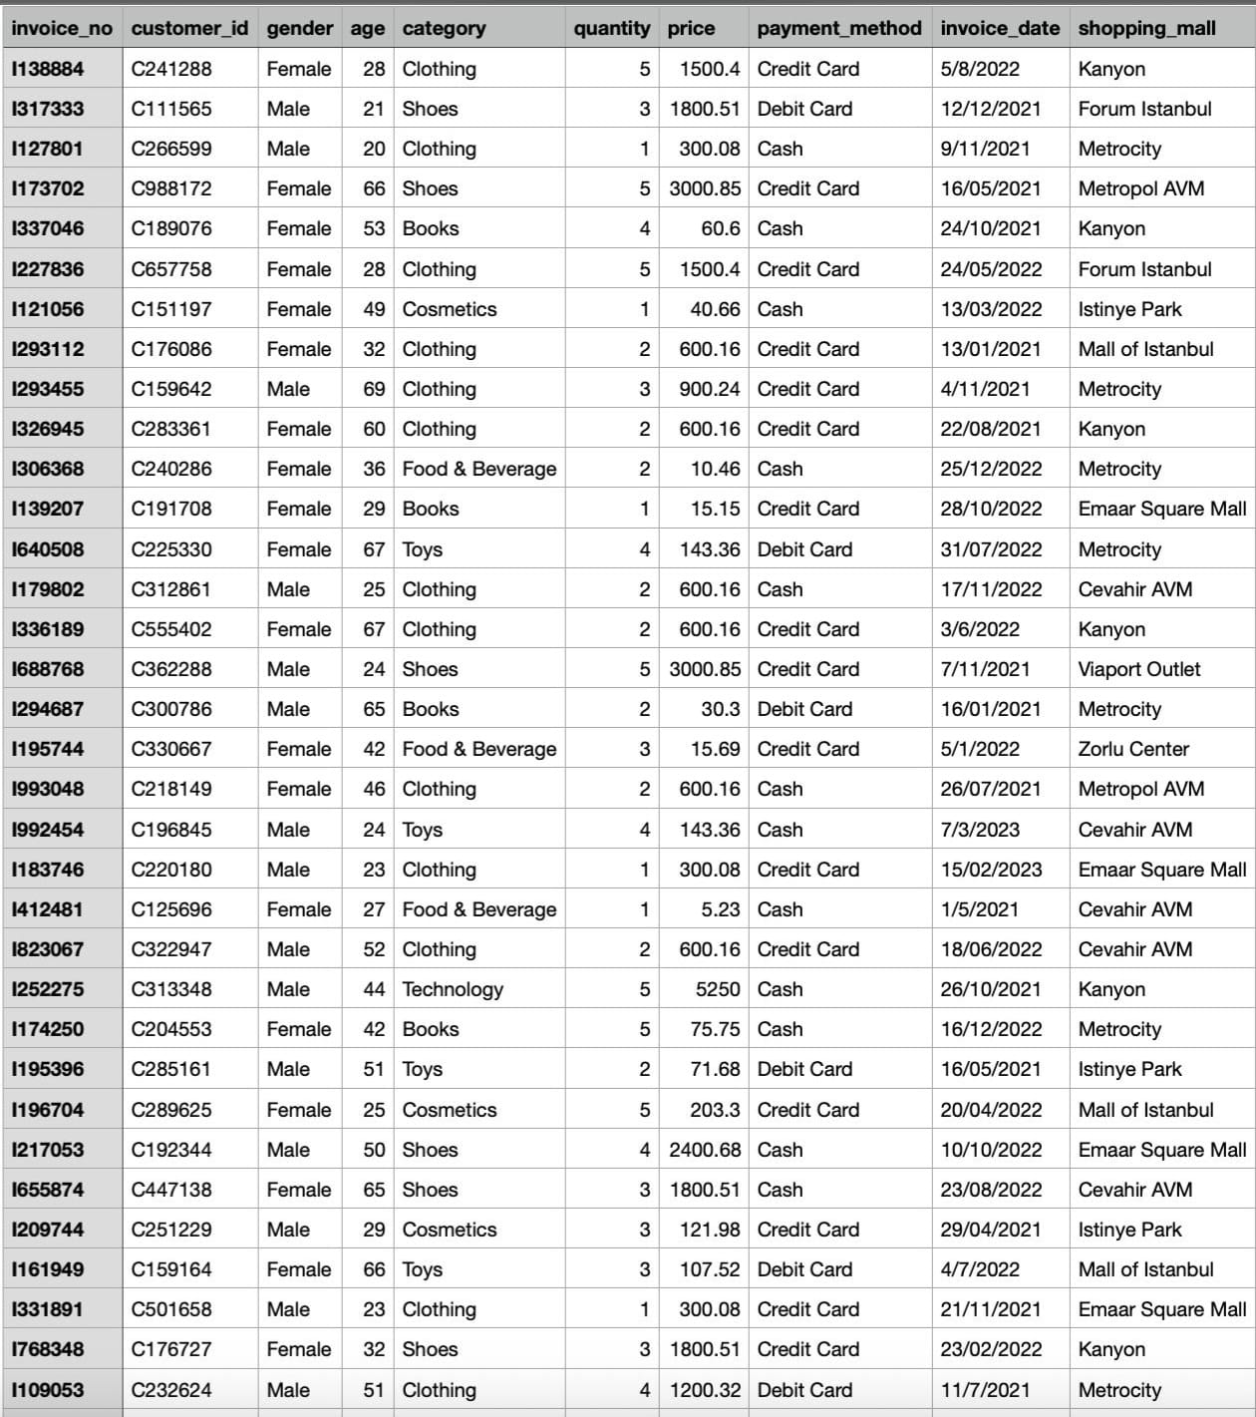
dataset

Slide 6
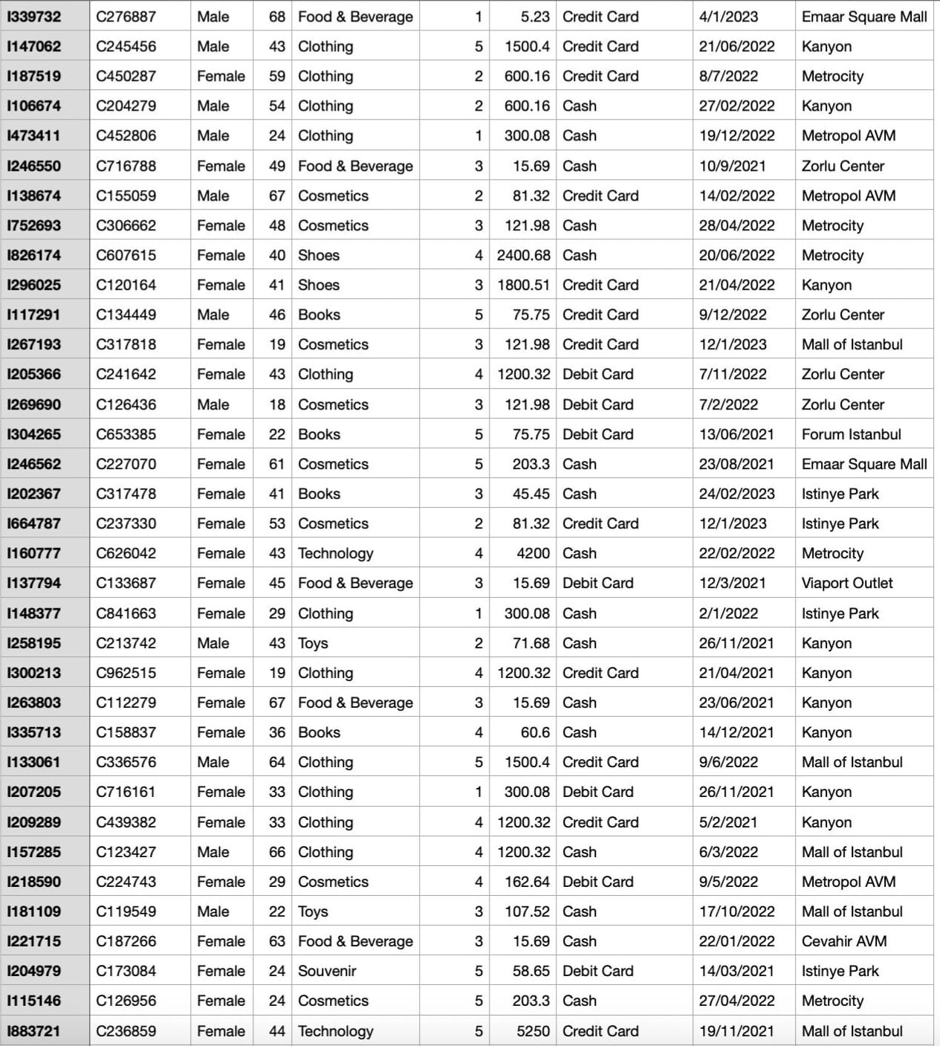
dataset

Slide 7
KEY DETAILS
The dataset used here is Customer Shopping Data.
It contains 3,900+ transaction records collected from multiple shopping malls, covering a variety of shopping activities.
It include details about the items bought, payment mode, and demographic information.
This data includes customers of all ages and genders, across various product categories. This dataset helps in exploring how customers from different backgrounds interact with products and payment systems in real-world retail settings.

Slide 8
KEY DETAILS
The dataset includes ten major columns, each contributing to a different aspect of the analysis:
Invoice No – Unique ID for every transaction.
Customer ID – Identifier assigned to each customer.
Gender – Indicates the gender of the customer.
Age – Represents the customer’s age.
Category – Product type or shopping category.
Quantity – Number of items purchased.
Price – Price per item in the transaction.
Payment Method – Mode of payment used (Cash, Card).
Invoice Date – Date of purchase
Shopping Mall – Name of the mall where the purchase occurred.

Slide 9
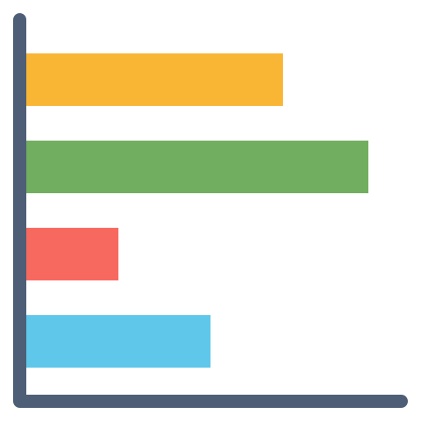
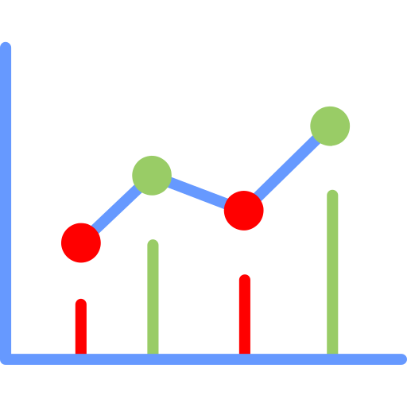
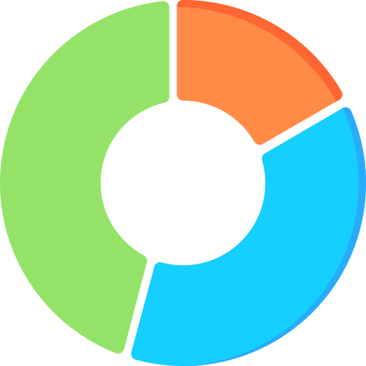
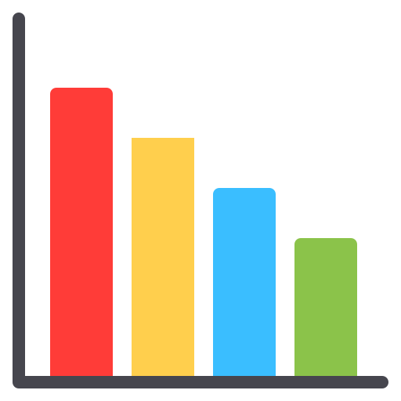
CRITERIA USED
Sales by Product Category - Column chart
Sales Trend Over Time - Line chart
Customer Sales by Gender - Donut chart
Mall Performance Comparison - Bar chart

Slide 10
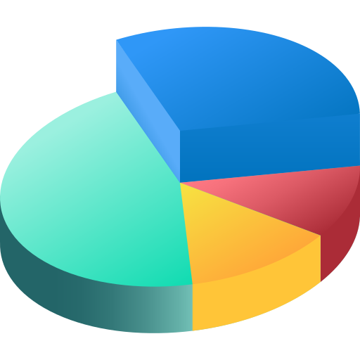
CRITERIA USED
Payment Method Analysis - Pie chart
Total Sales - Card
Average Order value - Card
Total Transaction - Card

Slide 11

CRITERIA USED
Date - Slicer
Category - Slicer
Age Group - Slicer

Slide 12
CRITERIA USED
3 new measures has been created to calculate the Sales ,Transaction and Order value.
Total Sales = SUMX(customer_shopping_data, customer_shopping_data[quantity] * customer_shopping_data[price])
Total Transactions = DISTINCTCOUNT(customer_shopping_data[invoice_no])
Average Order Value = DIVIDE([Total Sales], [Total Transactions])

Slide 13
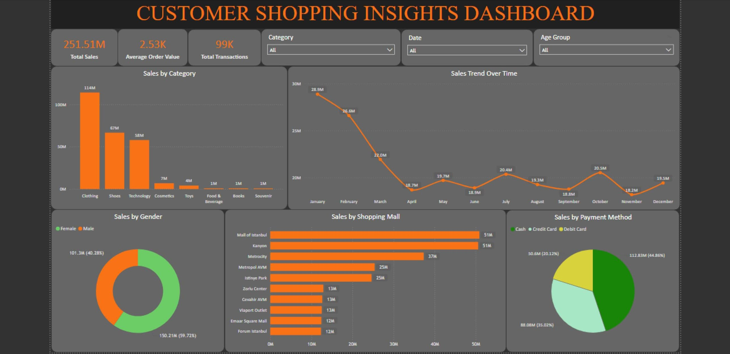

Slide 14
CONCLUSION
The Power BI dashboard gives a clear view of customer shopping behaviour across different malls. Total sales reached ₹251.51 million with an average order value of ₹2.53K and around 99K transactions. The top-selling categories were Clothing, Shoes, and Technology, with female customers contributing more to sales than males. Cash was the most preferred payment method, followed by credit and debit cards.
Overall, the analysis shows that Power BI effectively turns raw data into useful insights. It helps businesses understand customer trends, improve marketing strategies, and make better decisions to boost sales and customer satisfaction.

Slide 15


REFERENCE
https://www.kaggle.com/datasets/mehmettahiraslan/customer-shopping-dataset
Visualization

Slide 16
THANK YOU

